Slide 1
Turning engaging mathematics classroom experiences into robust learning
Peter Sullivan and Caroline Brown

Slide 2
Abstract
There is now clear evidence that more challenging open-ended tasks engage all students in learning mathematics, including those who learn easily and those who find learning mathematics difficult. The next step is to convert those engaging experiences into flexible learning that can be transferred to other contexts. This session will outline key actions for teachers including articulating the relevant mathematics and the use of similar tasks to follow up and consolidate the learning activated by the initial challenge.

Slide 3
Overview
The rationale(s) for trying something different
What might the something be?
What might the something look like?

Slide 4
The rationale(s) for exploring ways to augment our repertoires
Many of the best students (who have been taught using explicit methods) seem to have dodgy outcomes
Growth between years 7 and 9 is limited (in the extreme) so we are entitled to question text book approaches
Some responses from our research this year that suggests that many students prefer student centred methods
Some opinions world wide that argue that the better the task (that the students work on prior to instruction) the better the quality of the learning

Slide 5
Areas of weakness on examiners report (on Vic specialist mathematics) included
The quality of students’ handwriting and the manner in which they set out their mathematics continues to be of concern. Students should be reminded that if an assessor cannot read a student’s writing or is not certain as to what it is conveying, marks cannot be awarded.
Furthermore, students are expected to set out their work properly. If an assessor is unable to follow a student’s working (or reasoning), full marks will not be awarded. Equals signs should be placed between quantities that are equal – the working should not appear to be a number of disjointed statements.

Slide 6
not reading the question carefully enough – this included not answering the question, proceeding further than required or not giving the answer in the specified form. Students should be reminded that good examination technique includes rereading the question after it has been answered …

Slide 7
algebraic skills – …The inability to simplify expressions often prevented some students from completing a question. Incorrect attempts to factorise, expand and simplify, and the poor use of brackets were common
arithmetic skills – Difficulty with arithmetic was evident in several questions. The inability to evaluate expressions, especially those involving fractions, was common

Slide 8
showing a given result – … students need to include sufficient relevant working to demonstrate that they know how to derive the result.

Slide 9
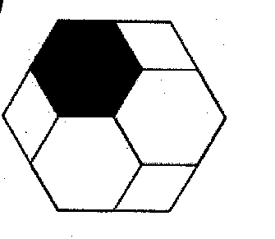
This shape is made with three regular hexagons and three rhombuses
Which fraction of the shape is black?

Slide 10
40% of the students in Year 7 nationally could answer it correctly
43% of the Year 9 students could answer it

Slide 11
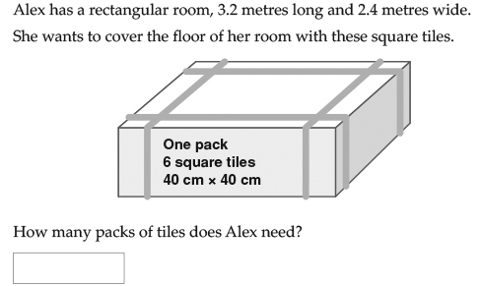

Slide 12
 | Nat Year 7 | Nat Year 9
% correct | 11% | 20%

Slide 13
It seems that the effectiveness of text book driven approaches are able to be questioned
But what might be alternatives?

Slide 14
Multiplicative Comparisons
If this represents 3 , draw what represents 1
(work this out two different ways)

Slide 15
QUESTION 7
If this represents $1\frac{1}{3}$
what represents $\frac{1}{2}$ ?
A B C D

Slide 16
QUESTION 8
Think about question 7 (the one with the squares).
I prefer questions we work on in class to be: (choose one option)
 | PRE TEST |  | POST TEST
 | year 7 | year 8 | year 7 | year 8
Much harder | 21% | 21% | 29% | 23%
about the same | 67% | 69% | 65% | 67%
much easier | 11% | 10% | 6% | 10%
Total | 386 | 858 | 363 | 768

Slide 17
QUESTION 9
Think about question 7 (the one with the squares).
I prefer learning how to do questions like question 7: (choose one option)
 | PRE TEST |  | POST TEST
 | year 7 | year 8 | year 7 | year 8
By myself | 16% | 23% | 19% | 23%
Working with other students | 33% | 42% | 39% | 36%
listening to the teacher's explanations first | 51% | 35% | 42% | 41%
Total | 386 | 837 | 365 | 769

Slide 18
Only correct responses (year 7 and 8 combined)
 | Much harder | about the same | much easier
By myself | 17% | 12% | 1%
Working with other students | 10% | 24% | 2%
By listening to the teacher's explanations first | 8% | 23% | 3%

Slide 19
There is agreement that tasks are important
“in the mathematics classroom, it is through tasks, more than in any other way, that opportunities to learn are made available to the students” (Anthony & Walshaw, 2009, p.96).

Slide 20
And those tasks should be challenging
Christiansen and Walther (1986) argued that non-routine tasks, because of the interplay between different aspects of learning, provide optimal conditions for cognitive development in which new knowledge is constructed relationally and items of earlier knowledge are recognised and evaluated.

Slide 21
Especially if we wish to go beyond developing fluency …
Kilpatrick et al. (2001)
  teachers who seek to engage students in developing adaptive reasoning and strategic competence (or problem solving) should provide them with tasks that are designed to foster those actions.

Slide 22
… and the tasks can address the goals of the curriculum …
National Council of Teachers of Mathematics (NCTM) (2014) noted:
  Student learning is greatest in classrooms where the tasks consistently encourage high-level student thinking and reasoning and least in classrooms where the tasks are routinely procedural in nature. (p. 17)

Slide 23
So how can we respond?

Slide 24
Cognitive activation tasks require students (prior to instruction) to
plan their approach, especially sequencing more than one step;
process multiple pieces of information, with an expectation that they make connections between those pieces, and see concepts in new ways;
choose their own strategies, goals, and level of accessing the task;
spend time on the task and record their thinking;
explain their strategies and justify their thinking to the teacher and other students.

Slide 25
Should we start easy and wind it up or start challenging and wind it back?
Students benefit when they move from not knowing how to do something to knowing how to do it.
In other words, what they have learned is explicit to them.
  This does not necessarily happen if they are working on the “known”.
When confronted with a task that they cannot do, students need to explore their existing mental structures and schemes, explore links, build connections and identify aspects that are unknown for themselves.

Slide 26
“Mindsets” offers us a helpful metaphor
Dweck (2000) categorized students’ approaches in terms of whether they hold either growth mindset or fixed mindset

Slide 27
Teachers can change mindsets
the things they affirm (effort, persistence, co-operation, learning from others, flexible thinking)
the way they affirm
    You did not give up even though you were stuck
    You tried something different
    You tried to find more than one answer
the types of tasks posed and the ways that lessons are structured

Slide 28
Getting started
“zone of confusion”
“four before me”
  representing what the task is asking in a different way such as drawing a cartoon or a diagram, rewriting the question …
  choosing a different approach to the task, which includes rereading the question, making a guess at the answer, working backwards …
  asking a peer for a hint on how to get started
  looking at the recent pages in the workbook or textbook for examples.

Slide 29
Assumptions
students are not reasoning if they are merely repeating an argument developed by someone else – the reasoning needs to be their own
Students are not solving problems if they have been told what to do
thinking … takes time and that it happens only when students are working on tasks that they do not know how to solve.

Slide 30

A lesson - Comparing fractions
Explain how to work out which is bigger :
$$\frac{2}{3} or \frac{201}{301}$$
Use two different methods.

Slide 31

Most students were confident that $\frac{2}{3}$ was smaller than $\frac{201}{301}$ but some had difficulty initially trying to justify this.

Slide 32
Consolidating Task to establish learning
Five groups of 3 fractions to order

Slide 34
Findings from Consolidating Task
Having a variety of methods to use when ordering fractions meant that students could select a method that was appropriate to the types of fractions being compared.
When the fractions were smaller, the preferred method was a diagram to explain.
When the fractions were more difficult, residual thinking or decimals were the preferred method.

Slide 35
Most students seemed to have developed a better understanding of the size of fractions from the ideas that arose in the class discussion.
Some of the students who used residual thinking in the consolidating task had not used this for the challenging task but had picked up this idea from the class discussion and then used it.
Most students could correctly order the fractions given.

Slide 36
Reflection on using challenging tasks
This challenging task took one lesson to complete and the consolidating task was completed for homework. Did not take longer than “traditional”lesson to do.
If the challenging tasks took a little longer we found that we got “bang for our buck” as students retained the concepts and the ideas seemed to be correctly transferred to new situations more often than seen in the past
Challenging tasks seemed to allow students to explore fractions as concepts in their own time and develop ideas for themselves

Slide 37
Having to explain their thinking to others made the misconceptions explicit for both students and their teachers
This allowed teachers to address incorrect reasoning and misconceptions in their teaching
It allowed students to develop a variety of methods so that they could choose the method based on the types of fractions to be ordered

Slide 38
Semester 2 Examination
Students had more confidence to try unfamiliar questions in the Semester 2 examination. No Year 7 students left any questions blank.
In Semester 2 Examination in November there was a question on ordering fractions.
21 out of 22 students in the class got it correct.

Slide 39
Semester 2 Reflections: What has worked well for you in Maths this semester?
I feel I have learnt so much not only this semester but this whole year. I can’t believe how much knowledge I have gained
Using different techniques to work things out
I have learnt Maths isn’t just about methods and answers but is about your learning and how you got the end result. Maths has always been hard for me before but I feel more confident and the results also show my learning.
Having class discussions about work we’ve done and doing questions together
When we work as a class so I can see how other people do operations to extend my skills
The different methods have helped me to understand
Giving multiple strategies also helped a lot
Understanding things myself after not understanding them

Slide 40
Our goal
To use what we know about turning points to explore properties of functions.

Slide 41
The first task I used
I was not paying attention in my mathematics class. I heard the teacher say that “a turning point is at (2, -3)”.
What might have been the function? (give at least two different possibilities)

Slide 42
What is the mathematics content we hope students will learn (or activate)?
How many different approaches might you hope that the students might use?

Slide 43
If you are stuck
I was not paying attention in my mathematics class. I heard the teacher say that “a turning point is at (0, -3)”.
What might have been the function?

Slide 44
If you have finished
What is a third different strategy for finding a function given a particular turning point?

Slide 45
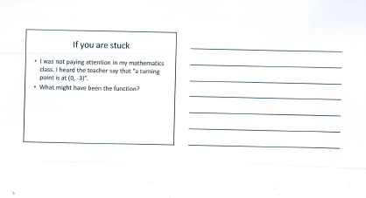
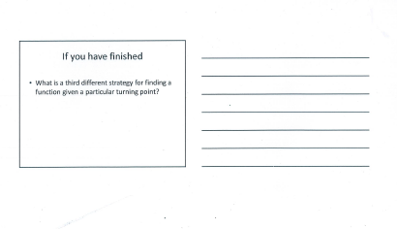

Slide 46
Turning Point 2
I was not paying attention in my mathematics class. I heard the teacher say that “a turning point is at (2, 3)”.
What might have been the function?
(give at least two different possibilities)

Slide 47
Of the students who handed up their sheets, there were …
1 student who gave one response to task 1 and only 1 to task 2
9 students who gave one response to task 1 and multiple responses to task 2
5 students who gave multiple responses to both

Slide 48
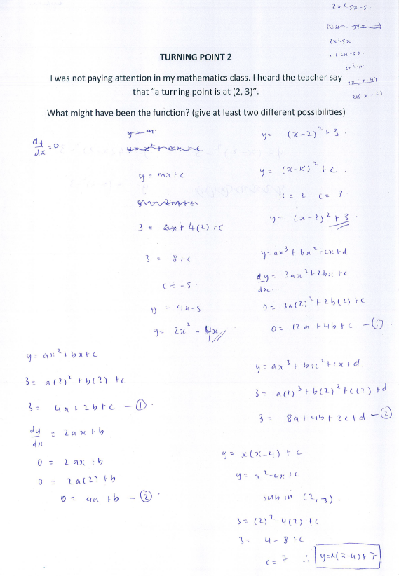
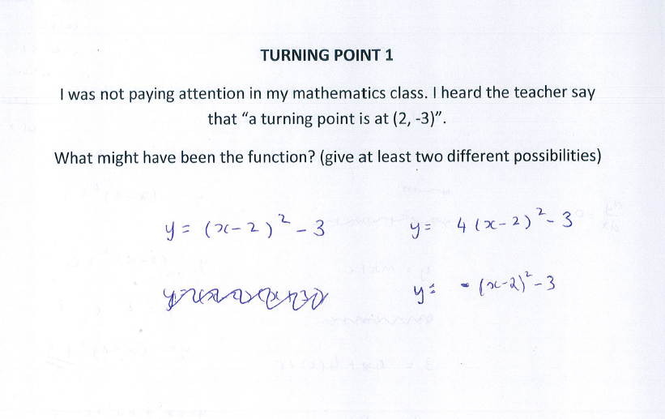
There were 9 out of 15 students whose responses looked like this

Slide 49
There were many different solutions
The formula method
The formula method generalised
Trig with amplitude of 3 (period π/4)
Trig with amplitude of 1
Assuming solutions symmetrical around x = 2, then translating the x axis e.g.
f(x) = x(x-4) + k
  f(x) = a (x - 5)² (x + 1)²
Substituting values into a gradient equation, then anti- differentiating (Chloe)
1 used absolute values

Slide 50
On the rubric

Slide 51
My reflection
More students used the same approach
y = a(x –h )² + k
than I expected and so it would have been better to prompt a second approach from the start
There was a second easy method that no-one used for task 1 (using the symmetry of the parabola) although some even used it for a quartic in task 2
The examples and solution strategies were diverse and it was hard to check their work for accuracy, or even be aware of the diversity in approaches, in the class
They were not good at explaining. Neither was I (which might explain why it is common at this level to choose a single method and think about its presentation)
Some students generalised right at the start, some found a trig solution without sketching the graph, and generally their work was accurate
Their handwriting made it hard to read their work, and some write the digits ambiguously
They gave unnecessarily moderate self evaluations on the rubric

Slide 52
Based on the work sheets, most students broadened their strategies from task 1 to task 2
Perhaps they had more time, or perhaps the discussion with the group helped

Slide 53
It would have been better as …
I was not paying attention in my mathematics class. I heard the teacher say that “a turning point is at (2, -3)”.
What might have been the function?
(give at least two different possibilities)
(use two different approaches for each possibility)

Slide 54
A revised lesson structure
Launch
Explore
Summarise
In this view, the sequence
  Launch (without telling)
  Explore (for themselves)
  Summarise (drawing on the
  learning of the students)
… is cyclical and might happen more than once in a lesson (or learning sequence)

Slide 55
The lessons consist of
One or more challenging task(s)
One or more consolidating task(s) (see Dooley, 2012)
preliminary experiences that are pre-requisite but which do not detract from the challenge of the tasks
supplementary tasks that offer the potential for differentiating the experience through the use of
  enabling prompts (see Sullivan, et al., 2009) which can reduce the number of steps, simplify the complexity of the numbers, and vary the forms of representation for those students who cannot proceed with the task;
  extending prompts for students who complete the original task quickly which often prompt abstraction and generalisation of the solutions.

Slide 56
Mathematics by Inquiry
An Australian Government funded project to develop and disseminate a suite of high quality, innovative mathematics resources for students and teachers from F to Year 10 incorporating contemporary mathematics pedagogy exemplifying an inquiry approach.

Slide 57
Partners: The Australian Academy of Science in collaboration with the Australian Association of Mathematics Teachers
Funding and duration: $6.4 million from 1 November 2015 to 30 June 2018

Slide 58
What Mathematics by Inquiry will provide for teachers, schools and students:
A protocol providing a vision and rationale for teaching Mathematics by Inquiry
Exemplary Mathematics by Inquiry experiences at every level from foundation to year 10
Special topics, each being a substantial teaching resource addressing identified needs or exploring new boundaries
Professional resources, each highlighting an aspect of Mathematics by Inquiry informing individual teacher and whole school change
Dissemination via Scootle and the AAMT Dimensions portal, supported by 240 champions recruited and trained from across Australia.

Slide 59
Contacts
mbi@science.org.au
Executive Director: Dr Steve Thornton
steve.thornton@science.org.au
02 6201 9430

