Slide 1
Which of these corners is square?
Notes:
Which of these corners do you think is square?

Slide 2
Which of these corners is square?
Notes:
Now, only x out of you got this correct. Why might that be? Well, it turns out that, as humans, we find it very difficult to judge by eye what is and isn’t square. This isn’t surprising because…

Slide 3
Notes:
In nature, at the macro scale, the scale of the things that we see in our every day life, there’s no such thing as a perfect square.
That’s right, squares are a human creation, and they’re a very important creation that formed the foundation of a lot of human developments.
I say ‘macro’ because I assume that there are perfect squares in molecular structures or something like that…? I feel that there would be something approaching a perfect square in some geological formations, but I thought using the qualifier of ‘perfect’ would keep me safe.
Source: https://upload.wikimedia.org/wikipedia/commons/6/65/Posts_Brook_from_Norvin_Green_State_Forest_Lower_Trail.jpg

Slide 4
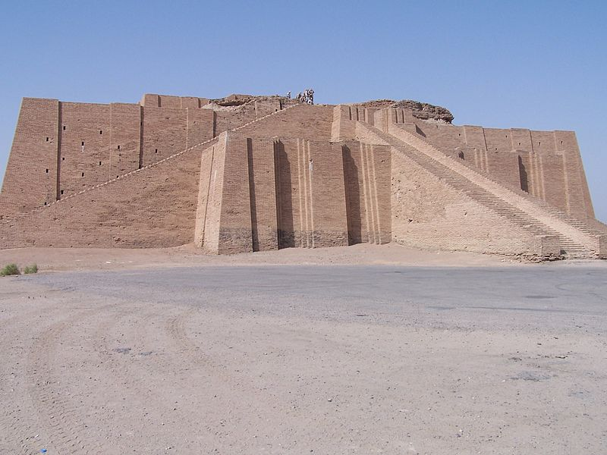
Notes:
This is an ancient mesopotamian ziggurat, build in about 2300 BC. Zigurrats were the precursors of the pyramids, that means they are the things that came before the pyramids, and you can see how important it would have been for the builders to be able to know what is and isn’t square. Imagine if they started building at this corner down here (indicating bottom left corner) but the two walls they were building in this direction (along front face) and this direction (along LHS face) weren’t exactly at right angles to each other. Would anyone like to raise their hand and share what they think would have happened?
in class I actually just told students what would have happened, they far corner wouldn't have lined up, but an observer in my class suggested that this could have been a good opportunity to ask a question.
Narration: So… how did these ancient Mesapotamians know what was and what wasn’t square?
Image source: http://www.architecture-student.com/architecture/architectural-styles-evolution-of-architecture/

Slide 5
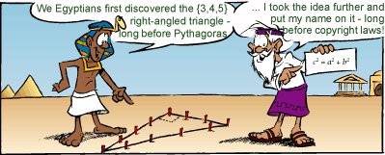
Pythagorean Triplets
4 is the length and 5 the diagonal. What is the breadth ?
Its size is not known.
4 times 4 is 16.
5 times 5 is 25.
You take 16 from 25 and there remains 9.
What times what shall
I take in order to get 9 ?
3 times 3 is 9.
3 is the breadth.
Babylonian tablet: 1900 BC to 1600 BC.
5
3
4
Notes:
Read appearing text.
This is some text from an ancient Babylonian tablet, that’s a big piece of stone with things carved in it. And it comes from a time a bit after that ziggurat that we were just looking at.
What were they talking about… any ideas?
Well, it turns out that what they were talking about is the construction of a shape like this one. (re-read to describe shape)
And it turns out that if you construct a triangle of side lengths 3, 4, 5, you’ll always end up with a right angled triangle.
Now, considering this text, Is there anything that particularly strikes you about iit?
Well, there were two things that struck me when I first read it. The first was that these people thought that this idea was important enough for someone to bother to sit down with a hammer and chisel and carve the idea into stone. And the next thing that struck me was that this civilization obviously hadn’t developed the mathematical formalisms that we use today. So instead of writing four squared to represent four times four, they had to write out the word ‘times’. How slow!
This 3, 4, 5 combination is only one of many combinations of side lengths that generate a right angled triangle. Here’s a list of a few other combinations.
These combinations are called ‘Pythagorean triplets’
And each of these combinations could have been used by the ancient Babylonians and Egyptians to construct things in ways that ensured that they were square.
The moral of this story is that this idea of ‘Pythagoras’ theorem’ was known about well before Pythagoras was around, he was born in 571 BC and that ziggurat that we saw before was from 2300 BC!
Cartoon image source: http://wps.pearsoned.com.au/uaensm7/113/29093/7447945.cw/index.html
Pythagorean triplets source: http://www.friesian.com/pythag.htm
Text source: http://www-history.mcs.st-and.ac.uk/HistTopics/Babylonian_Pythagoras.html

Slide 6
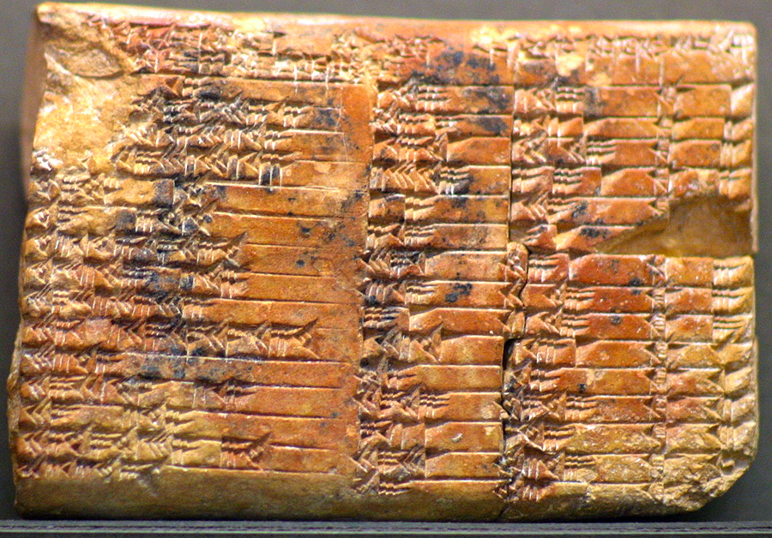
Notes:
http://www-history.mcs.st-and.ac.uk/HistTopics/Babylonian_Pythagoras.html
Plimpton tablet, 1800 BC.

Slide 7
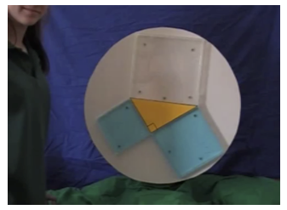
a²+b²=c²
Notes:
This is just an image for upload purposes. Find the clip here: https://www.youtube.com/watch?v=CAkMUdeB06o

